Slide 1
Business and Industrial Economics
A.Y. 2023/2024
Prof. Mattia Pedota
Alternative Theories of the Firm: Contractual and Holistic Approaches

Slide 2

The neoclassical firm
Firm
?
Input
Output
Max π
?
Governance

Slide 3
The neoclassical firm: Drawbacks
Critical issues:
Firm existence?
“The black box”?
Firm heterogeneity?
Profits as the only goal?
Alternative theories

Slide 4
Alternative theories of the firm
→ Economic and managerial theories
The aim is to explain
Firm existence
Firm behavior
Firm goals

Slide 5
Alternative theories of the firm: What is a firm?
Firms consist of different kinds of agents
Owner(s)
Providers of inputs: managers, workers
1. The contractual approach
Bundle of contracts
Diverse objectives within
No firm-level objectives
2. The holistic approach (including the neoclassical view)
Beyond linkages
Anthropomorphic vision
Firm-level objectives (no diverse objectives within)

Slide 6
The contractual approach
The contractual approach
Principal-Agent problem
Managerial theory
Team productivity theory
Contractual imperfections
Transaction costs theory
Property rights theory
The holistic approach (including the neoclassical view)
Resource-based theory
Evolutionary theory

Slide 7
The contractual approach: principal-agent problem
Owner-controlled firm: ownership = control
Managerial firm: ownership ≠ control
Shareholders (principals) vs. managers (agents)
Perfectly informed world → same outcomes
Reality → asymmetric information → discrepancy
Ownership fragmentation is negatively correlated with the incentive and ability to overcome these difficulties

Slide 8

The contractual approach: principal-agent problem
Most large firms are owned by a large number of (relatively small) stakeholders (e.g. publicly-traded companies)

Slide 9
The contractual approach: principal-agent problem
Main ways to mitigate the principal-agent issue:
Monitoring (e.g. board of directors)
Partial alignment of incentives (profit-contingent compensation)

Slide 10
The contractual approach
The contractual approach
Principal-Agent problem
Managerial theory
Team productivity theory
Contractual imperfections
Transaction costs theory
Property rights theory
The holistic approach (including the neoclassical view)
Resource-based theory
Evolutionary theory

Slide 11
The contractual approach: Managerial theory of the firm
Management ≠ Ownership
Managers goals ≠ Owners’ goals
Acceptable levels of profit
Maximization of their own utility
Baumol’s model of sales maximization
Managers’ goals: sales maximization
Owners’ goals: profit maximization

Slide 12
The contractual approach: Baumol’s model of sales maximization
Why do managers prefer to maximize sales and not profits?
Compensation is often linked to revenues
Personal prestige and visibility
Strategic and financial freedom
Profit maximization may entail cost-cutting, which is often a difficult decision

Slide 13
The contractual approach: Baumol’s model - Basic assumptions
Baumol (1959, “Business Behavior, Value and Growth”)
During the decision-making period, the CEO attempts to maximize sales
Sales maximization is subject to the provision of a minimum required profit to ensure a fair dividend to shareholders
This way, the stability of CEO’s job is assured
Conventional cost and revenue functions are assumed
Total costs increasing
Demand curve is downward sloping

Slide 14
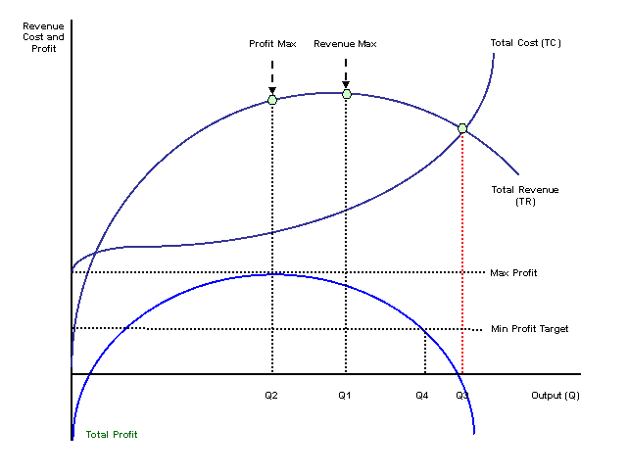
The contractual approach: Baumol’s model – graphical representation
≠

Slide 15
The contractual approach: Empirical evidence on managerial theory of the firm
Managerial theory of the firm - implications
Profit rates are higher in owner-controlled firms than managerial firms
The higher ownership concentration, the higher profits, ceteris paribus
Empirical evidence is mixed.

Slide 16
The contractual approach
The contractual approach
Principal-Agent problem
Managerial theory
Team productivity theory
Contractual imperfections
Transaction costs theory
Property rights theory
The holistic approach (including the neoclassical view)
Resource-based theory
Evolutionary theory

Slide 17
The contractual approach: Team production
Firm
TEAM PRODUCTION
Monitoring device
Metering problem
Individual contribution cannot be isolated and measured
Shirking Free-riding tendency
(Alchian and Demsetz, AER, 1972)

Slide 18
The contractual approach: Team production
No monitoring, individuals shirk or free-ride
“Insider monitor”
with special incentives (not to shirk)
“Residual claimant”
Monitor who receives what remains of the budget after team payments have been made
The monitor has interest to promote efficiency of the team
Bigger residual
Efficient team

Slide 19
The contractual approach
The contractual approach
Principal-Agent problem
Managerial theory
Team productivity theory
Contractual imperfections
Transaction costs theory
Property rights theory
The holistic approach (including the neoclassical view)
Resource-based theory
Evolutionary theory

Slide 20
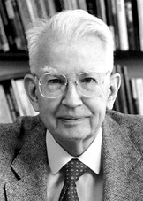
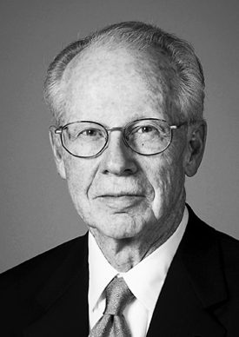
The contractual approach: Transaction cost theory
Coase 1937
Williamson 1986
Firms arise as a result of efficiency considerations
Production Costs + Coordination Costs < Market Price + Transaction Costs

Slide 21
The contractual approach: Transaction cost theory
Market transactions are plagued by transaction costs:
Search and information costs
Bargaining costs
Policing and enforcement cost
Firms arise whenever the cost of transacting through the market is greater than the cost of organizing transactions internally. Relevant determinants:
Bounded rationality
Opportunism
Relationship-specific investments
Frequency of transactions

Slide 22
The contractual approach
The contractual approach
Principal-Agent problem
Managerial theory
Team productivity theory
Contractual imperfections
Transaction costs theory
Property rights theory
The holistic approach (including the neoclassical view)
Resource-based theory
Evolutionary theory

Slide 23
The contractual approach: The property rights approach (Grossman & Hart 1986, JPE)
Contracts are necessarily incomplete: it is impossible to specify provisions for any possible state of the world
Renegotiations are likely to occur ex-post
Property rights influence the relative bargaining position of parties during renegotiations, as they allow residual rights of control
→ Ex-ante incentives to transact may suffer, especially when a relationship-specific investment is required →Transactions may not happen even when mutually beneficial

Slide 24
The contractual approach: The property rights approach (Grossman & Hart 1986, JPE)
Firms solve the problems arising from contract incompleteness
→ Like transaction costs theory, property rights theory is well-suited to explain both firm existence and vertical integration

Slide 25
The contractual approach
The contractual approach
Principal-Agent problem
Managerial theory
Team productivity theory
Contractual imperfections
Transaction costs theory
Property rights theory
The holistic approach (including the neoclassical view)
Resource-based theory
Evolutionary theory

Slide 26
The holistic approach: The resource-based view (RBV) of the firm
Profits are heterogeneous and sticky within markets and industries
SUSTAINABLE COMPETITIVE ADVANTAGE (SCA)
Persistently high profit levels over time
RBV does not challenge the neoclassical profit max assumption
RBV is interested in
what is a SCA
how can SCA be achieved
(Rumelt, 1984; Barney, 1991 and many others)

Slide 27
The holistic approach: The resource-based view (RBV) vs. the neoclassical approach
Neoclassical
RBV
Firm
Firm
Performance
Performance
Structure-conduct-performance paradigm
Firm is a bundle of resources

Slide 28
The holistic approach: The resource-based view (RBV) of the firm
Where does competitive advantage of stem from?
Possession of one or more resources that other firms do not possess.
Possession of a way to combine or deploy resources (i.e. a capability) that other firms cannot replicate.
Possession of a combination of resources that create the best “strategic fit” with the external environment.
Firm
Performance

Slide 29
The holistic approach: The resource-based view (RBV) of the firm
Types of resources:
Physical: cash, plants, equipment, technology, access to raw materials.
Human: training, experience, judgment, decision-making skills, intelligence, relationships, knowledge.
Organizational: Culture, reputation, formal reporting structures, control systems, coordinating systems, informal relationships.
Examples of capabilities: design, engineering, high-quality manufacturing, fast product development.

Slide 30
The holistic approach: The resource-based view (RBV) of the firm
Knowledge is so important that it may lead to a peculiar kind of competitive advantage denoted as knowledge-based competitive advantage
The ability to acquire and accumulate knowledge is given by the firm’s absorptive capacity

Slide 31
The holistic approach: The resource-based view (RBV) of the firm
Dynamic capabilities are higher-order capabilities related to the reconfiguration of resources and (lower-order) capabilities.
They underlie the ability to sense opportunities and threats, seize opportunities, and transform extant resources and capabilities.

Slide 32
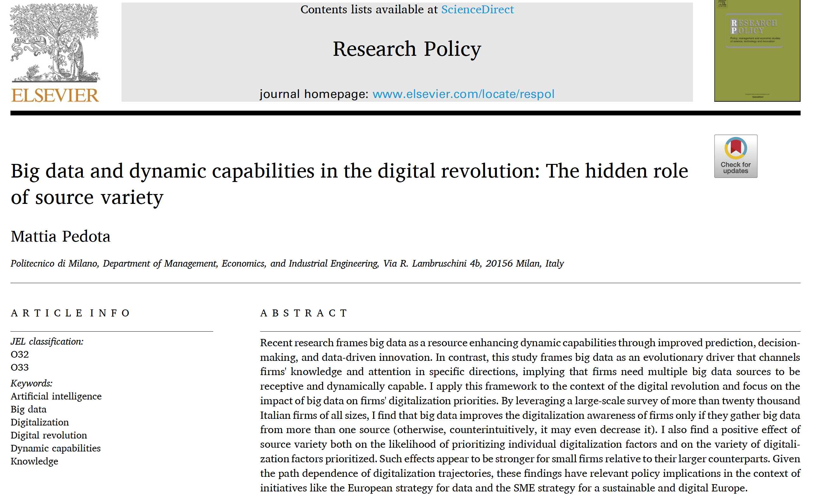
The holistic approach: The resource-based view (RBV) of the firm
Recent research shows that some resources (e.g. advanced technologies like AI-powered big data analytics) may improve dynamic capabilities

Slide 33
The holistic approach: The resource-based view (RBV) of the firm
Always remember that:
1) The external environment matters.
2) Some resources are key for a wide range of environments, others are not.
3) Sometimes it is a matter of combining resources rather collecting resources.

Slide 34
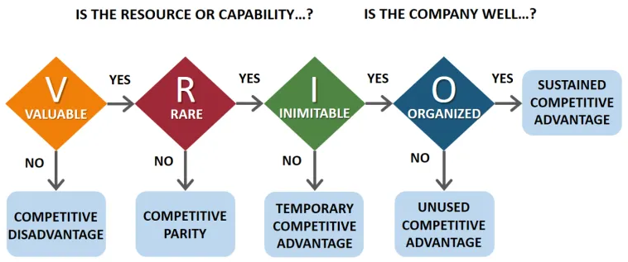
The holistic approach: The resource-based view (RBV) of the firm
What makes a resource (or a mix of resources) a firm possesses contribute to its competitive advantage?

Slide 35
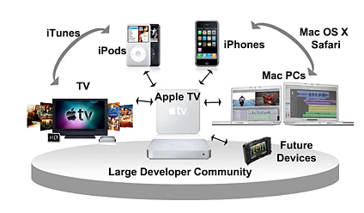


The holistic approach: The resource-based view (RBV) of the firm
Isolating mechanisms
Path-dependence of production processes and resources accumulation (e.g. ecosystem, brand reputation)

Slide 36
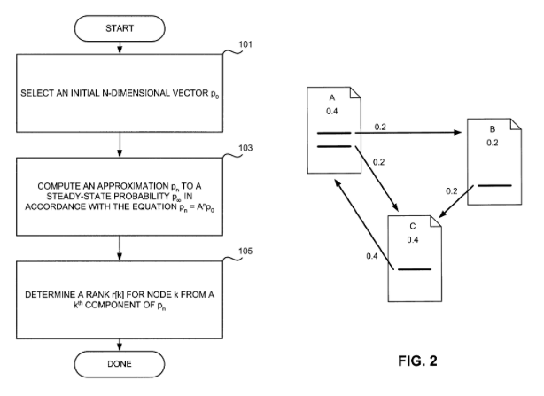
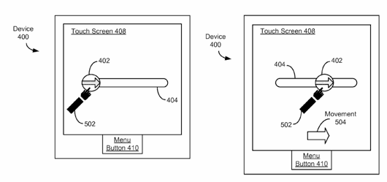
The holistic approach: The resource-based view (RBV) of the firm
Isolating mechanisms
Intellectual property rights (IPR) mechanisms (e.g. patents, secrecy)
Google’s page rank patent
Apple’s slide to unlock patent

Slide 37
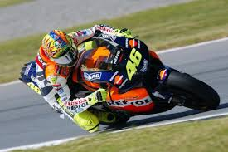
The holistic approach: The resource-based view (RBV) of the firm
Isolating mechanisms
Causal ambiguity – unclear where the advantage is coming from
HONDA
BIKE? (Honda engineers, mechanics, technicians, management)
or
DRIVER? (Valentino Rossi and his own team)
World Champion in 2002, 2003
36

Slide 38
The holistic approach
The contractual approach
Principal-Agent problem
Managerial theory
Team productivity theory
Contractual imperfections
Transaction costs theory
Property rights theory
The holistic approach (including the neoclassical view)
Resource-based theory
Evolutionary theory

Slide 39
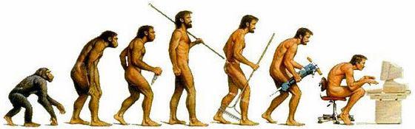
The holistic approach: The evolutionary view of the firm (Nelson and Winter, 1982, et al.)
(inspired by evolutionary biology)

Slide 40
The holistic approach: The evolutionary view of the firm (Nelson and Winter, 1982, et al.)
Even assuming profit maximization as the primary goal of the firm
Bounded rationality
Maximization is unfeasible
Need for a satisfactory (imperfect) criterion

Slide 41
The holistic approach: The evolutionary view of the firm (Nelson and Winter, 1982, et al.)
Develop strategies and practices that lead to a satisfactory level of performance
Over time, strategies and practices become ROUTINES
Firm is a bundle of routines

Slide 42
The holistic approach: The evolutionary view of the firm (Nelson and Winter, 1982, et al.)
Start
Develop routines
Follow the routines
Satisfactory level of performance reached?
Yes
No
Adjust the routines

Slide 43
The holistic approach: The evolutionary view of the firm (Nelson and Winter, 1982, et al.)
Search for new practices and strategies is constrained by the existing set of routines
“Firm’s genetic heritage”
Search
Success
Failure
New strategies and practices
Firm out of the market
New routines (new genetic heritage)
Firm survives
EVOLUTION

Slide 44

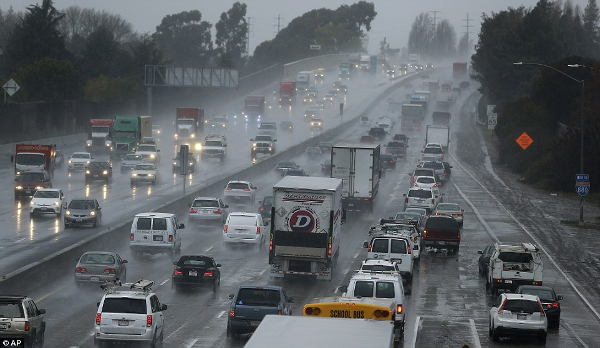
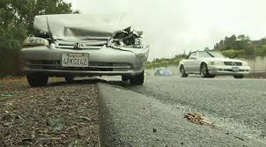
How wrong is the neoclassical approach?
“Assume a change of driving conditions occurs, say, that the roads have become wet and slippery and the fog has reduced visibility.”
✓
✗
“The theory is able to predict that traffic will be slower and accidents more frequent.”
“The theory is not able to predict that any particular driver will drive more slowly or have an accident.”

Slide 45

Questions?

Slide 46
References
Cabral, Chapter 3 (1st and 2nd edition)
Further reading:
Besanko et al., pp. 132 and pp. 367-378
Jenkins, M. and V. Ambrosini, “Strategic Management”, Chapter 7
Alchian, Armen A. and Demsetz, H. (1972), “Production, Information Costs, and Economic Organization”, 62 American Economic Review, 772-795.
Pedota, M. (2023). Big data and dynamic capabilities in the digital revolution: The hidden role of source variety. Research Policy, 52(7), 104812.

